Slide 1
Ethics In Government

Slide 2
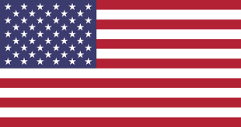
What is Ethics in Government?
Government ethics constitutes the application of ethical rules to government. It is that part of practical jurisprudence, or the philosophy of law, that governs the operation of government and its relationship with the people that it governs. It covers issues of honesty and transparency in government, dealing with matters such as bribery, political corruption, police corruption, legislative ethics, regulatory ethics, conflict of interest, avoiding the appearance of impropriety, open government, and legal ethics.
We will be discussing unethical acts in government, and how they affect the country, people, and the government

Slide 3
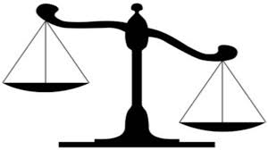
Ethics in Government Act of 1978
A United States federal law was established to interpret rules on standards of conduct, review top officials’ financial disclosure statements, provide education and training, and advise on enforcement of the rules
This act was created after the ethical violations of President Nixon in June of 1972 involving the Watergate Scandal. President Nixon resigned before he could be impeached. President Jimmy Carter signed this bill into law October 1978
Notes:
Reference # 1

Slide 4
Why Is Ethics Important in Government?
Ethics is important as results of scrupulous behaviors in our American government by politicians who betrayed the trust empowered to them by the people who elected them into office

Slide 5
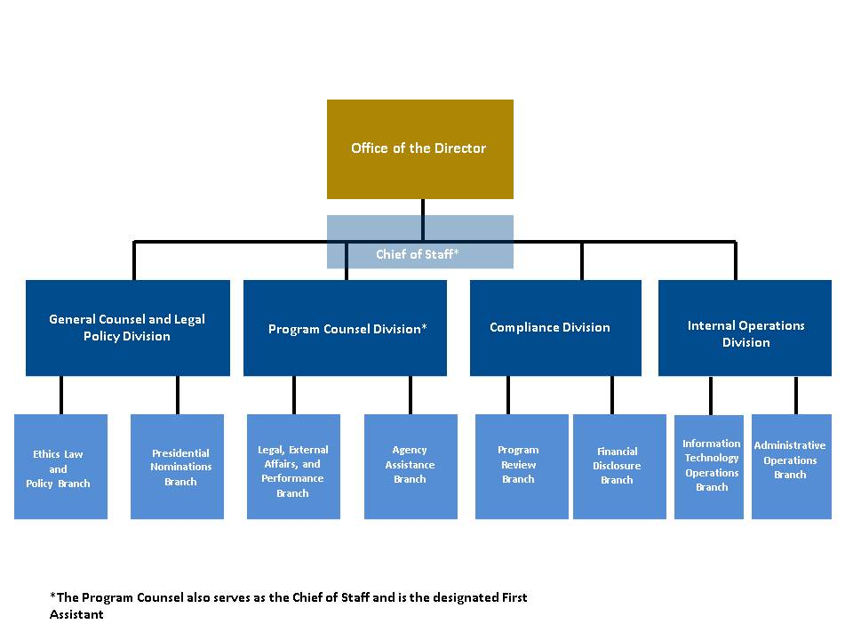
The United States Office of Government Ethics (USOGE) helps to prevent conflicts of interest in the executive branch. With today’s administration, it’s not surprising that some officials work to protect the integrity of these executives. Above is an organizational chart describing the chain of command in the OGE. Take notice of the striking resemblance it has to the Kennedy Space Center’s chain of command.

Slide 6
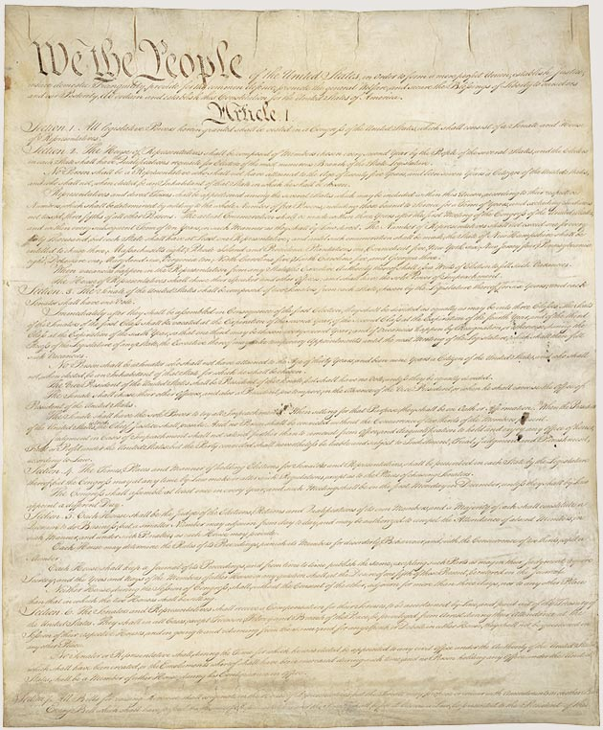
Constitutional Precedent
While there is no specific article that focuses on ethical behavior, people like Zephyr Teachout (2014) believe that “corruption was a purpose that motivated the Constitution.”[2]
The constitution does lay out what is expected from each branch of government and the checks and balances that are in place to not over reach in power
Notes:
https://scholarlycommons.law.northwestern.edu/cgi/viewcontent.cgi?article=1024&context=nulr_online

Slide 7
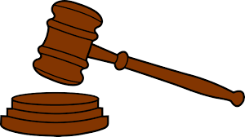
Laws and Court Rulings
U.S vs. Nixon (1974) [3]
Court ruling that determined that the US president cannot use executive privileges to withhold information from an investigation if National security won’t be compromised.
This was during the watergate scandal where the head prosecutor against Nixon ordered Oval Office tape recordings and Nixon refused stating executive privilege. Court ruled against Nixon.
Notes:
https://www.uscourts.gov/about-federal-courts/educational-resources/supreme-court-landmarks

Slide 8
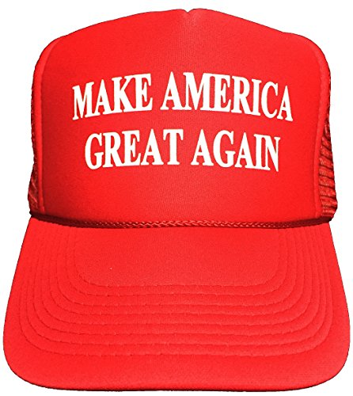
Drain The Swamp!
A quick search about corruption will bring up the animosity that the general public has for the current political system. Nearly Six out of Ten Americans think that the United States has become more corrupt. [4]
Current President Donald Trump based his entire election campaign on being an outsider and thus, not being bogged down by corruption.
Notes:
https://www.transparency.org/news/pressrelease/nearly_six_in_ten_americans_believe_the_us_became_more_corrupt_in_2017

Slide 9
Scott Pruitt, Former Head of the EPA
While head of the EPA, Scott Pruitt faced several charges that brought into question his ethics
Pruitt later resigned after these allegations of unethical behavior began to surface. [5]
Charges[5]:
Use of First-class travel on taxpayer money
Use of Staff for personal errands
Asked the CEO of Chick-fil-a if he could get his wife a franchise
Use of funds for security, trips to the Rose Bowl and many other personal vacations.
Notes:
https://www.cnn.com/2018/04/06/politics/scott-pruitt-controversies-list/index.html

Slide 10
Stakeholders
The stakeholders that would be affected would be citizens eligible to vote and those elected officials involved in unethical acts because citizens vote them in and they do it based on what elected officials are proposing.

Slide 11
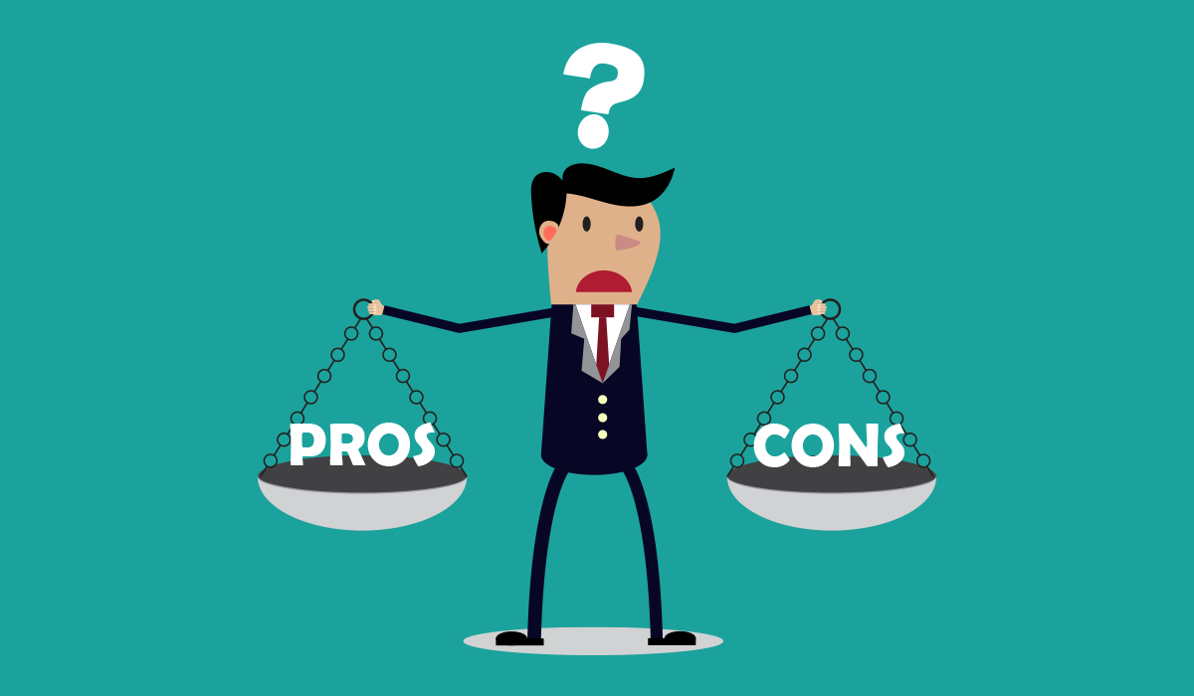
Pros and Cons of Ethics in Government
Pros
Keeps government officials from being corrupt and abusing power such as
* Bribery
* Extortion
* Blackmail
* Embezzlement
Citizens are at ease knowing that there won't be any type of misconduct from the government.
Cons
The only con is that ethics can be misinterpreted due to the fact that many people define ethics differently. What is unethical to someone might be ethical to another.
Notes:
https://www.houstoncrimedefense.com/blog/4-types-of-political-corruption/

Slide 12
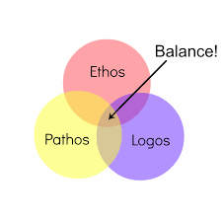
Summary
Ethics in government is a complex issue that does not have a simple answer, unfortunately. What is ethics in government?
It is an entire system that deals with corruption in the many forms that are seen.
Why is it important? Because without an ethical backbone in our government, there will be no one in the political system that can be trusted which leads to the American people being uninvested in the political system.
The systems that have been put into place by the scandals of the past help the future of our nation be less corrupted and more benevolent to the right people.
Committees are created and have standards to uphold to maintain moral and ethical choices in our government, to achieve this balance.
Notes:
Although the Constitution itself never specifically mentions what to do when there is corruption within the American political system, people believe that there was a lot of the constitution that was built with that in mind. One could argue that the checks and balances that are found within the Constitution are already anti-corruption measures that the founders thought of. One of the most pivotal moments in American history was the Watergate scandal that was caused by President Richard Nixon. Watergate exposed that the president had too much power when it came to whether or not the president was above the law. Although these rulings are in place, many people still have disdain for the current political system with 7 out of 10 americans thinking that the current government is more corrupt than ever. This is even more exemplified with the former head of the EPA, Scott Pruitt, being investigated with corruption charges.
With all this said, the people who are most affected by the ethics in government are the stakeholders. These people are the American people that vote and the elected officials that do these illegal activities. The stakeholders are also the people that need to weigh the pros and cons of these ethics. While the pros are fairly obvious, when there are more ethical people in government, the more trusted the government is. The only con is where other people think the ethical “line” is. As in, different people may think a certain action is ethical while another may not. This is very minor, as the only thing that could lead to is a brief argument. Overall, people need ethics in government to believe that the government is working for them and not for the interests of the selfish few.

Slide 13
References:
1. https://legcounsel.house.gov/Comps/Ethics%20In%20Government%20Act%20Of%201978.pdf
2. scholarlycommons.law.northwestern.edu. (2019). [online] Available at: https://scholarlycommons.law.northwestern.edu/cgi/viewcontent.cgi?article=1024&context=nulr_online [Accessed 24 Feb. 2019].
3.United States Courts. (2019). Supreme Court Landmarks. [online] Available at: https://www.uscourts.gov/about-federal-courts/educational-resources/supreme-court-landmarks [Accessed 24 Feb. 2019].
4.www.transparency.org. (2019). Nearly six in ten Americans believe the US became more corrupt in 2017. [online] Available at: https://www.transparency.org/news/pressrelease/nearly_six_in_ten_americans_believe_the_us_became_more_corrupt_in_2017 [Accessed 24 Feb. 2019].
5.Eli Watkins and Clare Foran, C. (2019). EPA chief Scott Pruitt's long list of controversies. [online] CNN. Available at: https://www.cnn.com/2018/04/06/politics/scott-pruitt-controversies-list/index.html [Accessed 24 Feb. 2019].
6.Houstoncrimedefense.com. (2019). 4 Types of Political Corruption. [online] Available at: https://www.houstoncrimedefense.com/blog/4-types-of-political-corruption/ [Accessed 24 Feb. 2019].

