Slide 1
College of Undergraduate Studies 2020-2021 UCF Orientation Program

Slide 2
Welcome to the College of Undergraduate Studies!
The College of Undergraduate Studies – Department of Interdisciplinary Studies offers several majors, minors, and certificates that incorporate a broader scope of curricula than traditional disciplinary academic programs. Each of our degree programs offers students an opportunity to tailor their curriculum to best reflect their interests and needs.
Online and campus-based majors
Bachelor of Arts or Science in Interdisciplinary Studies
Bachelor of Arts in Interdisciplinary Studies – Diversity Studies Track
Bachelor of General Studies in Integrative General Studies
Campus-based major (not online)
Bachelor of Science in Environmental Studies
Sciences Track and Communication and Planning Track

Slide 3
Catalog Year
For any student admitted for Summer 2020, Fall 2020, and Spring 2021, your catalog year is 2020-2021.
Depending on the date of your orientation, the undergraduate catalog may not be published. All information presented is to be used as a guide. Requirements for minors and certificates are subject to change.
If you have a minor or certificate, we highly encourage you to contact the department or college advising office for advising.
www.catalog.ucf.edu
.

Slide 4
Major Advising
All major advising is through the Department of Interdisciplinary Studies. We are appointment based and are currently only offering phone advising due to COVID-19.
To schedule an advising appointment email is@ucf.edu or request an appointment on our website, https://undergrad.ucf.edu/ids/. Our office is open Monday – Friday from 8:00 am till 5:00 pm.
We recommend that students touch base with at least once a semester for the following:
Planning coursework
Major specific questions
Internship opportunities
Graduation
General Education Requirements/State Core/Gordon Rule
Grade Forgiveness
University-Wide Requirements
General questions
Change of major, minor, or area of study
.

Slide 5
Minor advising is through the department of the minor or the associated college advising office. We recommend that students seek advisement for their minor on a regular basis. A full breakdown of the requirements for each minor can be found in the undergraduate catalog. If the minor is not housed in the College of Undergraduate Studies, we will not be able to answer specific questions related to the minor, prerequisite sequencing, course substitutions, or overrides.
Minor Advising

Slide 6
Things to Know & Important Reminders
Resolve Holds and To-Do items
Resolve any outstanding items in your Student Center of your myUCF account. Holds on your account can prevent registration.
Register for at least one course in the semester you have been admitted
If, for any reason, you are unable to take classes, please reach out to an advisor.
Memorize or have written down your UCF NID and password and your UCF ID.
If you have not accessed your myUCF account in a few weeks or months, you may need to reset your password.
Your NID to used for your myUCF portal. It is like your Social Security Number and typically this is not something you provide or give out to UCF faculty and staff.
Your UCF ID (also known as PID or Empl ID) is your student ID number. It is used when completing university paperwork, forms, and requesting advising appointments.
Create your Knights Email Account. This is how we will be communicating with you from now on – https://knightsmail.ucf.eduLinks to an external site.
Submit any outstanding final transcripts, test scores, and high school transcripts to Undergraduate Admissions.

Slide 7
UCF Email and Accessibility
Email
Your UCF Knights email is the official correspondence between the university, and you. Some instructors and professors may prefer to correspond via Webcourses. Always check your syllabus to determine the best way to reach your instructor or professor, find their office hours, and more.
We are not required to respond to emails from your personal email. Check your Knights email daily.
Phone
We may try reaching out to students via the phone number listed on their myUCF portal. Set up your voicemail and make sure there is sufficient space so that we can leave a voicemail.
Please be accessible and update your contact information (phone, address, emergency contact) if needed via your myUCF portal.

Slide 8
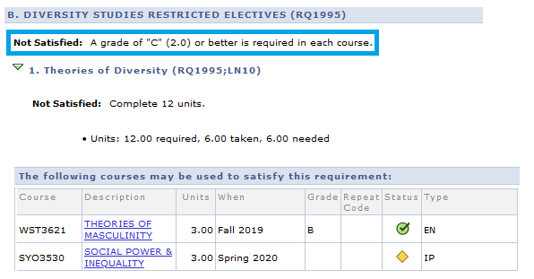
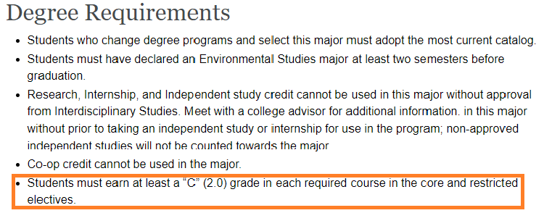
GPA and Academic Standing
UCF GPA
Your UCF GPA determines your academic standing. Only includes courses taken at UCF. Should your UCF GPA ever drop below a 2.00, you will be placed on Academic Probation.
Overall/Cumulative GPA
Your overall or cumulative GPA includes all coursework from all institutions attended. Transfer coursework & UCF Coursework.
Courses for your Major
The undergraduate catalog and your myKnightAudit will also highlight the minimum grade required for your major. In most cases, students need to earn at minimum a "C" (2.00) or better. A "C-" (1.75) is below a "C".

Slide 9
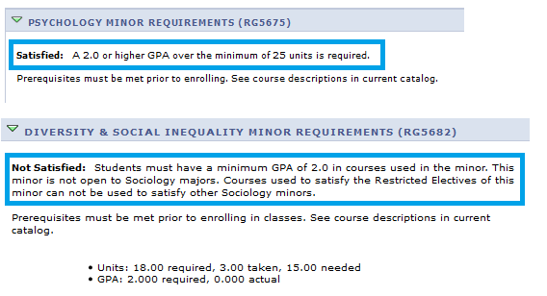
GPA and Academic Standing
GPA for Minors and Certificates
Depending on the major you select in the College of Undergraduate Studies, you may be required to have a minor. Minors can have Admission and GPA requirements. This information will also be displayed in your myKnightAudit. Certificates are optional but have GPA requirements as well.
Academic Probation
If your UCF GPA drops below a 2.00, you will be placed on academic probation.

Slide 10
University Graduation Requirements and GEP
University Graduation Requirements
All students regardless of major must satisfy these minimum university graduation requirements.
State Core/General Education/Civic Literacy/Gordon Rule
High school foreign language admission requirement
120 credit hours
48 upper-level credits
2.00 UCF GPA
30 credits earned in residence (taken) at UCF
High School Foreign Language
Students are required to have two years of high school foreign language or proficiency through the second semester of college-level language. This requirement applies to all undergraduates and is separate from the UCF Foreign Language proficiency requirement for Bachelor of Arts degrees.
College-level foreign language
All Bachelor of Arts degrees require proficiency through the second semester of college-level foreign language. This can be satisfied with various test credit, Dual Enrollment, transfer credit, UCF coursework, or a proficiency exam. This is not the same as the high school foreign language admission requirement. Some Bachelor of Science degrees may have language as a program requirement.
General Education Program (GEP)/State Core/Civic Literacy/Gordon Rule Writing/Gordon Rule Math
Students transferring to UCF without an Associate of Arts (AA) degree from a Florida public institution are subject to satisfying UCF’s General Education Program (GEP). The GEP is 36 + credits of specific coursework.
If you are transferring from an out-of-state or private institution, in some cases, you may be advised to have courses evaluated for equivalency through Academic Services or the College of Sciences for math courses. These offices will require a copy of your course description and/or syllabi.
Academic Services: https://undergrad.ucf.edu/as/services/transfer-credit/.
College of Sciences: https://course-eval.sciences.ucf.edu/.

Slide 11
Course descriptions, prerequisites, & overrides
Courses and prerequisites
Due to the unique nature of our programs, most students will not have a prescriptive list of courses that they need to take to complete their program of study. Environmental Studies is an exception. Students are responsible for meeting prerequisites and corequisites of all courses they wish to enroll in. Some courses are major and/or minor specific. We highly encourage that students meet with an advisor once a semester for advising and schedule planning.
PR = Prerequisite
A prerequisite means a course or other requirement that a student must have taken prior to enrolling in a specific course or program. For example, Biology I is required to enroll in Biology II.
CR = Corequisite
A corequisite means a course or other requirement that a student must take at the same time as another course or requirement.
CI = Consent of Instructor
Requires permission of the instructor to enroll.
Finding course descriptions and prerequisites
Students can find prerequisites and course descriptions utilizing the following. We encourage our students to use the catalog and their myUCF portal when reviewing course descriptions and class offerings. myScheduleBuilder may not contain a full list of courses and it currently does not verify prerequisites.
1. Undergraduate Catalog (www.catalog.ucf.edu)
2. myUCF → Browse Course Catalog
3. myUCF → Search for Classes

Slide 12
Credit Hours, Lower & Upper-Level Credits
Credit Hour or Semester Hour
Every course taught is designated a total number of credit hours. The number of credit hours for a class reflects approximately the total hours a student spends per week. Most lecture courses are 3 credit hours and meet 3 hours per week. Students should expect to spend at least two hours of study time outside of the class for every hour spent in class. "Hours" "Credits" and "Credit Hours" are interchangeable terms.
Lower-level credits
Lower-level credits are courses with a number of 1000-2999 (not less than 1000). The course number can be found directly after the course prefix. These are examples of lower-level credits. The first number after the prefix starts with either a 1 or a 2.
ENC 1102
MAC 2312
Upper-level credits
Students must have at minimum 48 upper-level credits to graduation from UCF.
Upper-level courses are courses with a course number of 3000-4999. The course number can be found directly after the course prefix. These are examples of upper-level credits. The first number after the prefix starts with either a 3 or a 4.
LDR 3115
IDS 4934

Slide 13
What’s Next?
We will explore our academic programs.
We encourage that you take notes of the program(s) you are interested in. Write down any questions that you have.
After the presentation, we will break up into small groups or one-on-one advising. During this time, you will be able to change your program of study or complete the declaration process.
You will be able to ask questions.
Schedule planning and course suggestions will be provided.

Slide 15
Bachelor of Science in
Environmental Studies
Program Information

Slide 16
Bachelor of Science in
Environmental Studies
Program Information
Bachelor of Science in Environmental Studies
The Bachelor of Science in Environmental Studies prepares students for several interesting and challenging careers. Its interdisciplinary nature provides students with tools that can be applied across a spectrum of science, social behavior, and humanities, using the strengths of the various areas. Students seeking journalistic or artistic careers will gain the scientific background necessary to understand environmental science, while students going into the sciences will gain the social, political, and ethical background necessary to understand environmental actions and policy decisions. This degree cannot be completed online.
To ensure that students demonstrate a sufficient understanding of the course material and learning objectives of this academic program, only grades of “C” (2.0) or higher or “S” may be used to satisfy program requirements.
Students are required to select a track in the Sciences or Communication and Planning.

Slide 17
Bachelor of Science in
Environmental Studies
Program Information
General Education Program (GEP)
The General Education Program at UCF is waived with an AA degree from a Florida public state college or community college. These courses should be taken as part of your GEP/AA as they are required for your major. If they were not taken, they are still required. The following reflects UCF’s GEP.
GEP 1: ENC 1101 – English I
GEP 2: ENC 1102 – English II
GEP 3: COM 1000, SPC 1603, OR SPC 1608
GEP 4: Historical/Cultural Foundation
GEP 5: Historical/Cultural Foundation
GEP 6: Historical/Cultural Foundation
GEP 7: MAC 1105 – College Algebra
GEP 8: STA 2023 – Statistics
GEP 9: SYG 2000 – Sociology
GEP 10: ECO 2023 – Microeconomics
GEP 11: CHM 2040 and CHM 2041 or CHM 2045C (lecture and lab) **
GEP 12: BSC 2010C – Biology I
Civic Literacy
Students must have four Gordon Rule Writing Courses (GRW) typically GEP 1, 2, and two additional classes from GEP 4, 5, 6.
Students must also satisfy State Core from each foundation area.
** Enrollment in CHM 2045C requires successful completion of the Chemistry Placement Exam **
An advisor will discuss your specific requirements when we break out into smaller groups or one-on-one advising.
High School Foreign Language Admission Requirement
Two years of high school foreign language. Students must submit an official high school transcript to Undergraduate Admissions. If you did not complete this requirement in high school, it is an automatic graduation requirement.
.

Slide 18
Environmental Studies
Core Classes – Varies
BSC 2010C – Biology I
BSC 2011C – Biology II
CHM 2040 and CHM 2041 or CHM 2045C
STA 2023 – Statistics
MAC 1105 – College Algebra
SYG 2000 – Intro to Sociology
ECO 2023 – Microeconomics
PCB 3044 - Principles of Ecology
PCB 3044L - Principles of Ecology Lab
Track – 18 upper-level credits
Students must select a track in either the Sciences or Communication and Planning. Each track requires the completion of 18 credit hours. The track you select should be based on your goals and desired career field.
Additional Requirement – Varies
Students are required to complete one of the following.
2nd semester of college-level language, XXX 1121C
Internship
Service-Learning Course (cannot overlap with a class required for the major)
Undergraduate Research
Fundamentals/Advanced Core – 22 upper-level credits
ECP 3302 – Economics and the Environment
GIS 3043C – GIS for Env. Studies
PUP 3203 – Environmental Politics
GIS 4301C – Advanced GIS for Env. Studies
IDS 3150 – Foundations of Env. Studies
ISC 3523 – Research Methods for Env. Studies
SYD 4510 – Environment and Society
Electives – As needed
May be required to meet university graduation requirements of 120 credit hours, 48 upper-level credits. This will depend on AP/Test Credit/Dual Enrollment/Transfer Credit brought into the university.
Capstone in Environmental Studies – 3 upper-level credits
Students are required to take this course in their graduating semester. Applying for graduation is the prerequisite.
EVR 4940 – Capstone in Env. Studies
College-level Language
One semester of college-level foreign language. Your high school transcript WILL NOT satisfy this requirement. Let your advisor know if you are fluent in another language.
XXX 1120C

Slide 19
Chemistry Placement Test
Environmental Studies majors have two options:
CHM 2045C, lecture & lab (4 credits total)
CHM 2040 and CHM 2041 (3 credits each, 6 total)
CHM 2045C requires successful completion of the Chemistry Placement Exam. NO REPEATS.
If you do not score high enough on this exam, take CHM 2040 and CHM 2041.
If you do not want to take the placement exam, take CHM 2040 and CHM 2041.

Slide 20
Chemistry Placement Test
To request access, send an email to the Chemistry department using your Knights email.
This may take a few weeks. BE PROACTIVE!
Include: Full name and NID
Chemplacement@ucf.edu
One hour to take exam
Cannot retake

Slide 21
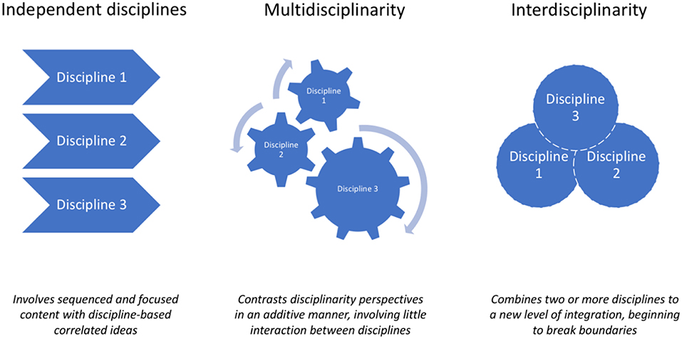
Bachelor of Arts or Science in
Interdisciplinary Studies
Program Information

Slide 22
Bachelor of Arts or Science in
Interdisciplinary Studies
Program Information
Bachelor of Arts or Science in Interdisciplinary Studies
This program works best if students have a clear goal for after graduation in mind and if you have multiple interests. Students are required to study and integrate three different disciplines. Students are required to take two core classes, two areas of study, and one minor. The Interdisciplinary Studies program leads to either a Bachelor of Arts or Bachelor of Science degree depending upon the selected areas of study and minor. A full breakdown of the requirements is provided.
To ensure that students demonstrate a sufficient understanding of the course material and learning objectives of this academic program, only grades of “C” (2.0) or better or ”S” may be used to satisfy program requirements.
Additional Information
A student’s degree type (Bachelor of Arts or Bachelor of Science) is determined by their two areas of study and minor. Your diploma will list your major of Interdisciplinary Studies. The areas and minor will not be listed. The areas are not listed on our transcript.

Slide 23
Bachelor of Arts or Science in
Interdisciplinary Studies
Program Information
General Education Program (GEP)
The General Education Program at UCF is waived with an AA degree from a Florida public state college or community college. The following reflects UCF’s GEP.
GEP 1: ENC 1101 – English I
GEP 2: ENC 1102 – English II
GEP 3: COM 1000, SPC 1603, OR SPC 1608
GEP 4: Historical/Cultural Foundation
GEP 5: Historical/Cultural Foundation
GEP 6: Historical/Cultural Foundation
GEP 7: Mathematical Foundation
GEP 8: Mathematical Foundation
GEP 9: Social Foundation
GEP 10: Social Foundation
GEP 11: Science Foundation - Physical
GEP 12: Science Foundation - Life Science
Civic Literacy
Students must have four Gordon Rule Writing Courses (GRW) typically GEP 1, 2, and two additional classes from GEP 4, 5, 6.
Students must also satisfy State Core from each foundation area.
An advisor will discuss your specific requirements when we break out into smaller groups or one-on-one advising.
High School Foreign Language Admission Requirement
Two years of high school foreign language. Students must submit an official high school transcript to Undergraduate Admissions. If you did not complete this requirement in high school, it is an automatic graduation requirement.

Slide 24
Bachelor of Arts or Science in
Interdisciplinary Studies
Program Information
Area of Study – 15 credit hours
****Area of Study that can be completed online****
Select one.
Arts (BA)
Behavioral and Social Sciences (BA) ****
Commerce (BS)
Communication (BA) ****
Computational Sciences (BS)
Education (BS) ****
Engineering (BS)
Health (BS) ****
Humanities (BA) ****
Letters and Modern Languages (BA) ****
Life and Biomedical Sciences (BS)
Physical Sciences (BS)
Public Affairs (BS) ****
Interdisciplinary Studies Cornerstone – 3 upper-level credits
Prerequisite is ENC 1102. Required first semester in the major or when the prerequisite has been met.
IDS 3933 – Cornerstone Experience
Required Minor – 18 + credit hours
A minor is required for this major and it is at least 18 credit hours. A full list of minors can be found on our website. The areas of study and minors cannot be related, undergrad.ucf.edu/ids
College-level Language or Multicultural Requirement – Varies
Bachelor of Arts degree type requires proficiency through the second-semester of the college-level foreign language. AP, CLEP, or FLATS examination can also satisfy this requirement.
Bachelor of Science degree type requires one semester of a college-level foreign language or approved multicultural course substitution. Let your advisor know if you can speak a foreign language.
Areas of Study
Exit Requirements
15 of the 30 credits total must be earned at UCF
15 of the 30 credits total must be upper-level, XXX 3000-4999
Second Area of Study – 15 credit hours
Select one. Area 2 must be different than area 1.
Arts (BA)
Behavioral and Social Sciences (BA) ****
Commerce (BS)
Communication (BA) ****
Computational Sciences (BS)
Education (BS) ****
Engineering (BS)
Health (BS) ****
Humanities (BA) ****
Letters and Modern Languages (BA) ****
Life and Biomedical Sciences (BS)
Physical Sciences (BS)
Public Affairs (BS) ****
Electives – As needed
May be required to meet university graduation requirements of 120 credit hours, 48 upper-level credits. This will depend on AP/test Credit/Dual Enrollment/Transfer Credit brought into the university.
Interdisciplinary Studies Capstone – 3 upper-level credits
Students are required to take this course in their graduating semester.
IDS 4934 – Capstone Experience

Slide 25
Bachelor of Arts or Science in
Interdisciplinary Studies
Program Information
Select Courses for the Areas
For the 2020-2021 catalog, the areas of study will be prefixed based. If the prefix falls underneath your area of study, it will count if passed with a “C” or better or “S” grade. Interdisciplinary Studies is a university-wide program that generates access to many courses, assuming all prerequisites are completed. However, departments may put a priority on registering their own majors and limit registration for non-majors.
As an example, any courses with these prefixes will count for the area of Behavioral and Social Sciences
Selecting Courses for your Minor
Your degree audit should be updated in time for course registration. A full list of course suggestions or required coursework should be found in your myKnight Audit. The undergraduate catalog should also provide a list of requirements.
ANT Anthropology
CLP Clinical Behavior
CPO Comparative Politics
DEP Developmental Psychology
EAB Experimental Analysis of Behavior
EXP Experimental Psychology
GEO Geography: Systematic
INP Industrial & Applied Psychology
INR International Relations
PCO Psychology for Counseling
POS Political Science
POT Political Theory
PPE Psychology of Personality
PSB Psychobiology
PSY Psychology
PUP Public Policy
SOP Social Psychology
SYA Sociology Analysis
SYD Sociology of Demography, Area Studies, Sociological Minorities
SYG Sociology, General
SYO Sociology, Social Organizations
SYP Sociology, Social Processes
OR these specific courses:
APK 3400

Slide 26
Bachelor of Arts in
Interdisciplinary Studies – Diversity Studies Track
Program Information

Slide 27
Bachelor of Arts in
Interdisciplinary Studies – Diversity Studies Track
Program Information
Bachelor of Arts in Interdisciplinary Studies – Diversity Studies Track
This is one of the most structured degree programs that we offer. Students are required to take two core classes, complete college-level foreign language, 30 credits of Restricted Electives, and one minor. A full breakdown of the requirements is provided below.
Diversity Studies examines human relations by looking at inequalities in gender, age, race, religion, nationality, ethnicity, sexuality, and socioeconomic standing in order to gain an understanding of cultures and human interactions. Students pursuing a career in social justice or advocacy work, involvement in international nonprofit organizations or diverse research and journalistic careers, as well as those seeking preparation for graduate study in related areas will enjoy the flexibility of this program.
To ensure that students demonstrate a sufficient understanding of the course material and learning objectives of this academic program, only grades of “C” (2.0) or higher or “S” grades may be used to satisfy program requirements.

Slide 28
Bachelor of Arts in
Interdisciplinary Studies – Diversity Studies Track
Program Information
General Education Program (GEP)
The General Education Program at UCF is waived with an AA degree from a Florida public state college or community college. The following reflects UCF’s GEP.
GEP 1: ENC 1101 – English I
GEP 2: ENC 1102 – English II
GEP 3: COM 1000, SPC 1603, OR SPC 1608
GEP 4: Historical/Cultural Foundation
GEP 5: Historical/Cultural Foundation
GEP 6: Historical/Cultural Foundation
GEP 7: Mathematical Foundation
GEP 8: Mathematical Foundation
GEP 9: Social Foundation
GEP 10: Social Foundation
GEP 11: Science Foundation - Physical
GEP 12: Science Foundation - Life Science
Civic Literacy
Students must have four Gordon Rule Writing Courses (GRW) typically GEP 1, 2, and two additional classes from GEP 4, 5, 6.
Students must also satisfy State Core from each foundation area.
An advisor will discuss your specific requirements when we break out into smaller groups or one-on-one advising.
High School Foreign Language Admission Requirement
Two years of high school foreign language. Students must submit an official high school transcript to Undergraduate Admissions. If you did not complete this requirement in high school, it is an automatic graduation requirement.

Slide 29
Bachelor of Arts in
Interdisciplinary Studies – Diversity Studies Track
Program Information
Interdisciplinary Studies Cornerstone – 3 upper-level credits
Prerequisite is ENC 1102. Required first semester in the major or when prerequisite has been met.
IDS 3933 – Cornerstone Experience
Required Minor – 18 + credit hours
A minor is required for this major and it is at least 18 credit hours. Minors that are underlined can be completed online.
Africana Studies
American Indian Studies
American Studies
Anthropology in Multicultural Studies
Asian Studies
Requires coursework in Chinese, Japanese, or Korean languages
Cultural Anthropology
Diversity and Social Inequality (sociology minor)
Global Peace and Security Studies
Humanities and Cultural Studies
International and Global Studies
Requires proficiency through the fourth semester of college-level foreign language
Judaic Studies
Requires Hebrew language coursework
Latin American Studies
Mass Culture and Collective Behavior (sociology minor)
Middle Eastern Studies
Religion and Cultural Studies
Women’s and Gender Studies
World Comparative Studies
Restricted Electives – 30 upper-level credits
Theories of Diversity – 12 upper-level credits from an approved list
Experiences and Representations of Diversity – 18 upper-level credits from an approved list
Classes from the Restricted Electives cannot overlap with your minor. A full list of courses can be found on our website, https://undergrad.ucf.edu/ids/programs/
College-level Language – Varies
Bachelor of Arts degree type requires proficiency through the second-semester of the college-level foreign language. AP, CLEP, or FLATS examination can also satisfy this requirement.
Electives – As needed
May be required to meet university graduation requirements of 120 credit hours, 48 upper-level credits. This will depend on AP/test Credit/Dual Enrollment/Transfer Credit brought into the university.
Interdisciplinary Studies Capstone – 3 upper-level credits
Students are required to take this course in their graduating semester.
IDS 4934 – Capstone Experience

Slide 30
Bachelor of General Studies in
Integrative General Studies (BIGS)
Program Information
Bachelor of General Studies in Integrative General Studies
This degree program makes the most of your transfer coursework and provides the most flexibility. Integrative General Studies can be as disciplinary or interdisciplinary as you would like. Although a minor is not required, students wishing for more structure or a focused curriculum may want to consider declaring one. Since this is a Bachelor of General Studies and not a Bachelor of Arts or Science, students are not required to take college-level foreign language unless it has not been satisfied through the admission requirement.
To ensure that students demonstrate a sufficient understanding of the course material and learning objectives of this academic program, only grades of “C” (2.0) or higher may be used to satisfy Core requirements.
Students interested in declaring this major must have completed 75 or more credit hours and meet with an advisor in the College of Undergraduate Studies – Department of Interdisciplinary Studies to complete the declaration process.
BIGS may not be completed as a double-major, double-degree, or second baccalaureate degree.

Slide 31
Integrative General Studies
Bachelor of General Studies in
Integrative General Studies (BIGS)
Program Information
General Education Program (GEP)
The General Education Program at UCF is waived with an AA degree from a Florida public state college or community college. The following reflects UCF’s GEP.
GEP 1: ENC 1101 – English I
GEP 2: ENC 1102 – English II
GEP 3: COM 1000, SPC 1603, OR SPC 1608
GEP 4: Historical/Cultural Foundation
GEP 5: Historical/Cultural Foundation
GEP 6: Historical/Cultural Foundation
GEP 7: Mathematical Foundation
GEP 8: Mathematical Foundation
GEP 9: Social Foundation
GEP 10: Social Foundation
GEP 11: Science Foundation - Physical
GEP 12: Science Foundation - Life Science
Civic Literacy
Students must have four Gordon Rule Writing Courses (GRW) typically GEP 1, 2, and two additional classes from GEP 4, 5, 6.
Students must also satisfy State Core from each foundation area.
An advisor will discuss your specific requirements when we break out into smaller groups or one-on-one advising.
High School Foreign Language Admission Requirement
Two years of high school foreign language. Students must submit an official high school transcript to Undergraduate Admissions. If you did not complete this requirement in high school, it is an automatic graduation requirement.

Slide 32
Integrative General Studies
Bachelor of General Studies in
Integrative General Studies (BIGS)
Program Information
Contemporary Issues in Leadership – 3 upper-level credits
Prerequisite is ENC 1102. Take in any semester.
LDR 3115 – Contemporary Issues in Leadership
Electives – 24 + credits
Required to meet university graduation requirements of 120 credit hours, 48 upper-level credits. This will depend on AP/test Credit/Dual Enrollment/Transfer Credit brought into the university.
Senior Seminar Capstone – 3 upper-level credits
Students are required to take this course in their graduating semester.
IDS 4939 – Senior Seminar Capstone

Slide 33
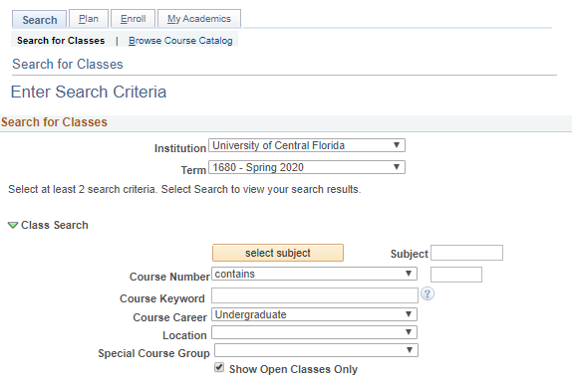
Course descriptions, prerequisites, & overrides
To find courses on the schedule, you can Search for Classes using your myUCF portal
Log in to your myUCF account
Under the myUCF Menu, click Student Self Service
Click “Search” or “Search for Classes”
After clicking “Search” or “Search for Classes” it will take you to the Search Criteria screen.

Slide 34
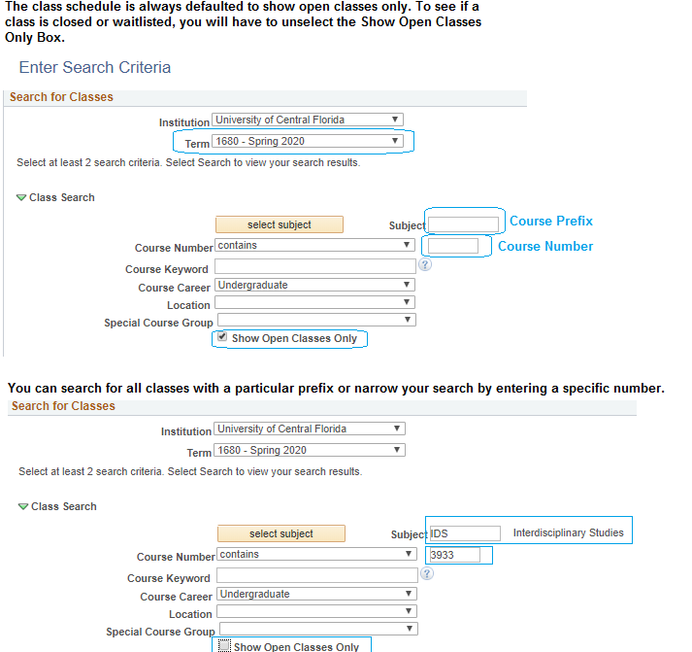
Course descriptions, prerequisites, & overrides
myUCF → Search for Classes
You always select your term (semester) FIRST

Slide 35
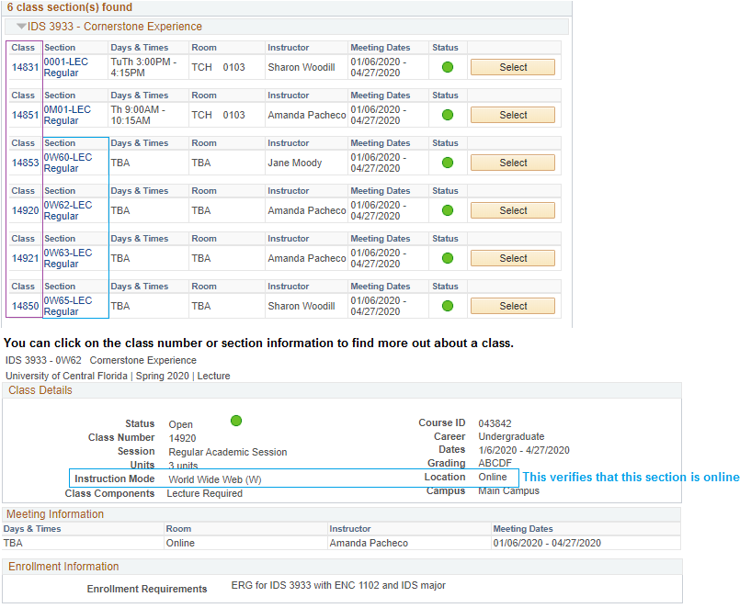
Course descriptions, prerequisites, & overrides
myUCF → Search for Classes

Slide 36
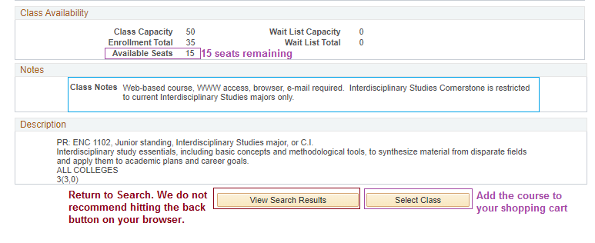
Course descriptions, prerequisites, & overrides
myUCF → Search for Classes
Overrides
If you are experiencing issues registering for classes, contact the college/department that teaches the course. We can only provide overrides for the courses taught through the College of Undergraduate Studies. Some courses are major/minor/certificate specific and preference can be given to students in those programs.

Slide 37
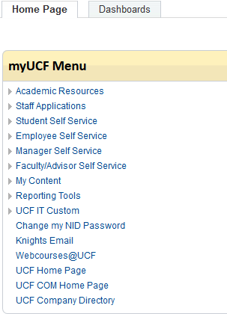
myUCF
You will need your NID and password to log in.
my.ucf.edu → Student Self Service → Student Center

Slide 38
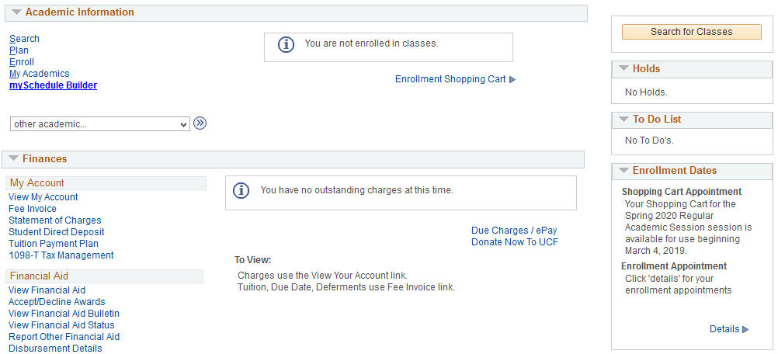
myUCF | Student Self Service
View Holds | To Do List | Enrollment Dates | myKnight Audit | Pegasus Path | Financial Aid, and more!

Slide 39
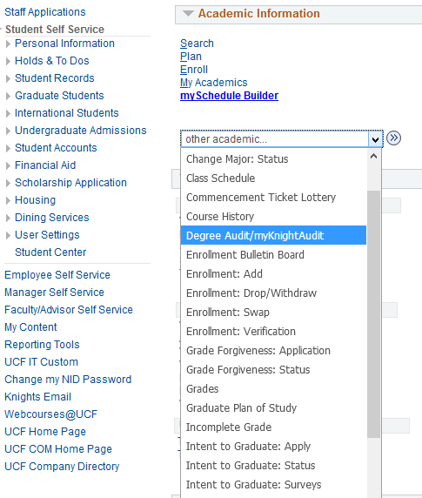
myUCF | other academic…
View Degree Audit | Grades | Apply for Graduation | Swap/Drop/Add/Withdraw classes and more!

Slide 40
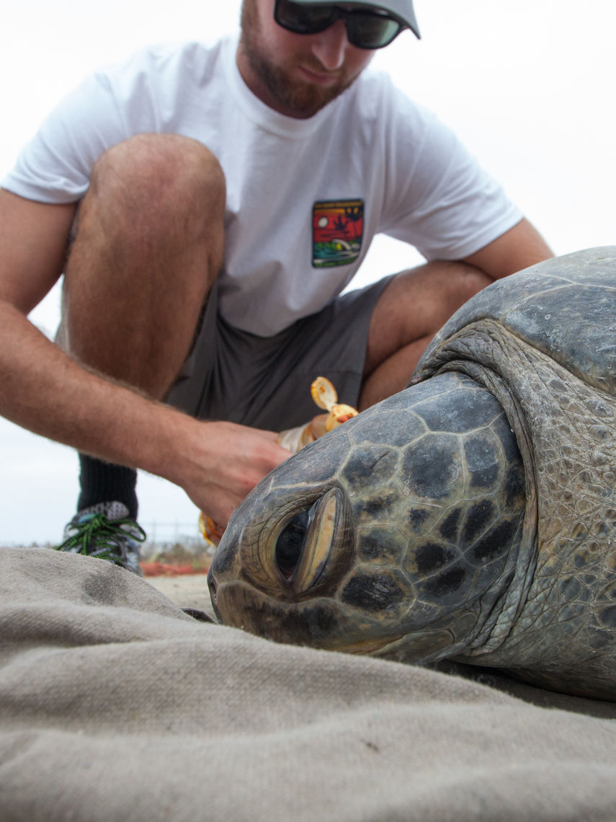
Enhance your Experience at UCF!
Although our degrees don’t require an internship…
Students who have an internship are 33% more likely to find a job after graduation.
• Pursue an Internship through Experiential Learning (www.csel.ucf.edu) ** Handshake **
• Participate in the UCF Job Shadow Program through Career Services
• Get involved in Research through the Office of Undergraduate Research
Work with faculty in fields such as: Biology, Chemistry, Psychology, Sociology, History, Optics.

Slide 41
IMPORTANT
SUBMIT YOUR OFFICIAL, FINAL TRANSCRIPT(S) and test scores.
If are taking classes or completing your AA Degree, we must have a final transcript that states your AA was earned in order to WAIVE UCF’s General Education Program Requirements. SUBMIT TO UNDERGRADUATE ADMISSIONS.
You must enroll in at least ONE Course for the semester you have been admitted.
A grade of a “C-” (1.75 GPA) is not the same as a “C” (2.00 GPA)
“C” or better grades are required for your major and in most cases, minors and certificates too.
Tutoring Resources SARC, SI (Supplement Instruction), and the Writing Center
https://sarc.sdes.ucf.edu/ | https://guides.ucf.edu/writingcenter
UCF Cares https://cares.sdes.ucf.edu/
Financial Aid https://www.ucf.edu/financial-aid/
Bookstore https://ucf.bncollege.com/shop/ucf/page/find-textbooks
NID password reset https://mynid.ucf.edu/pages/NidCheck.aspx
Create your Knights Email https://ucf.bncollege.com/shop/ucf/page/find-textbooks

Slide 42
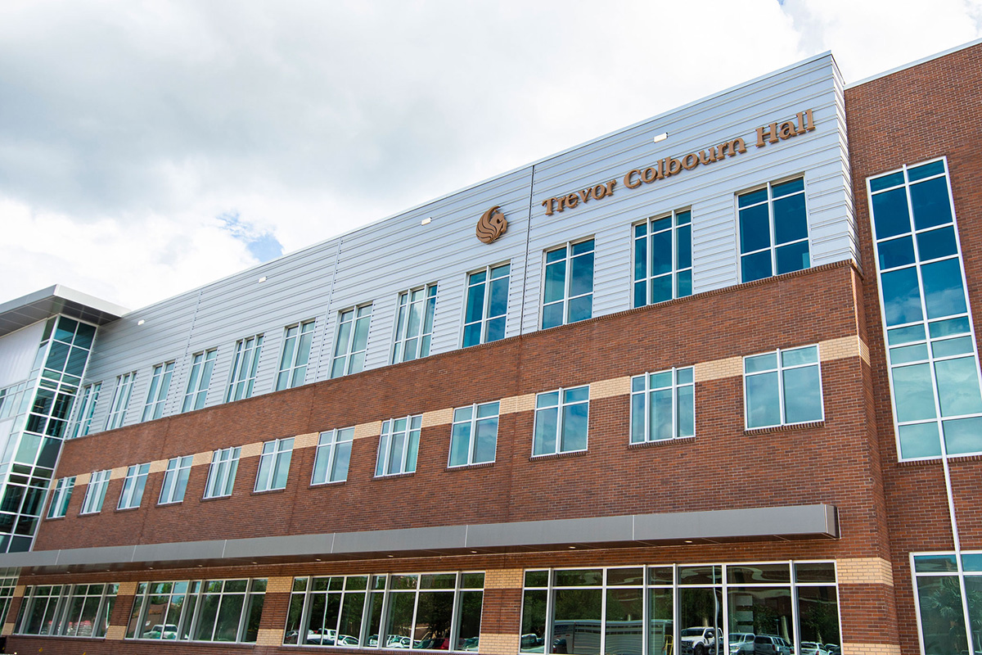
Due to COVID-19, we have suspended in-person meetings and walk-ins until further notice. Appointments can be requested via or website or by email. You will need to provide your first name, last name, UCF ID, and Knights Email.
Dept. of Interdisciplinary Studies
Trevor Colburn Hall, Suite 239
undergrad.ucf.edu/ids| is@ucf.edu |
Monday – Friday, 8:00 am – 5:00 pm
Advising Hours: M – F, 8:30 AM – 4:00 PM
To schedule an appointment email is@ucf.edu
OR
Request an appointment through our website

